Slide 1

The Hindu
A close-up view of the entrance to Kasturi Buildings, the head office of The Hindu
"Yesterday, Today, Tomorrow“
Founding Date : 20 September 1878
Owned by : The Hindu Group, Chennai

Slide 2
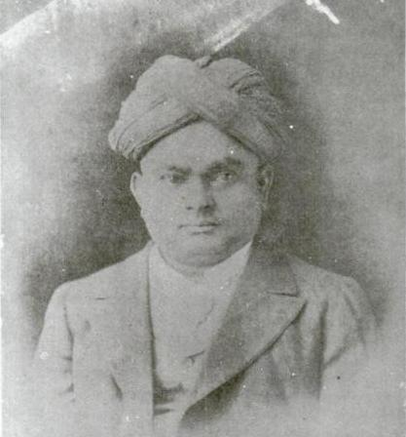
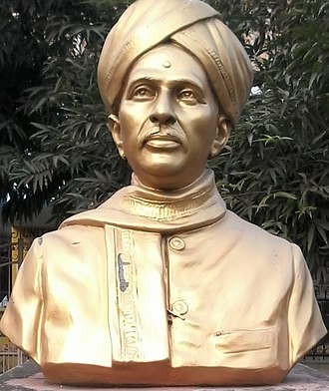

Reviews & Founders
G. Subramania Iyer (Jan 1855 –
April 1916)
N. Subba Rao Pantulu
(Jan 1856 – Jan 1941)
And 3 others,
namely,
T. T. Rangacharya,
P. V. Rangacharya,
D. Kesava Rao Pantulu,
The Hindu claim to be the most respected paper in India
India’s second most read English newspaper.

Slide 3
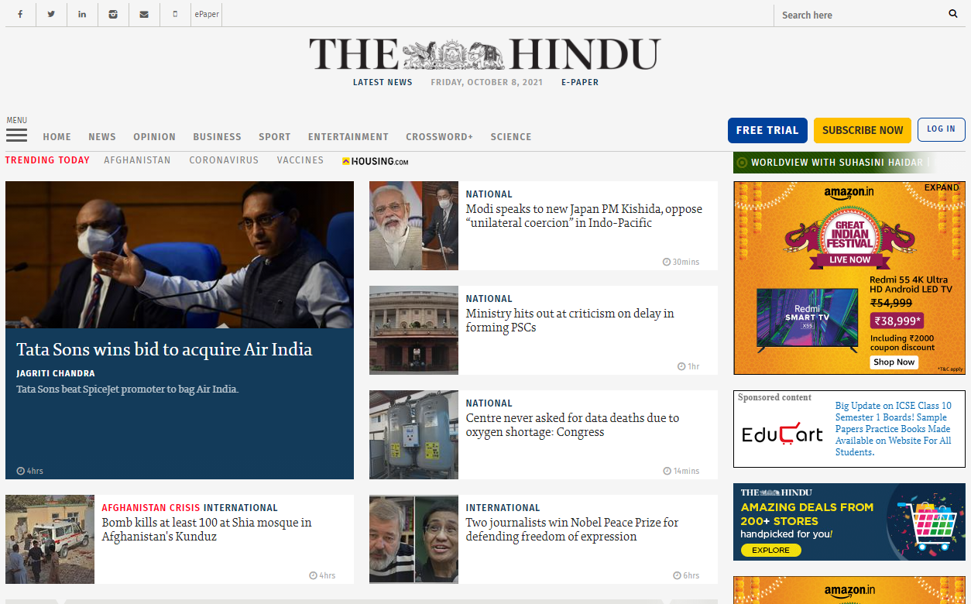
Online Presence
1
2
The First Newspaper in India to have a website, launched in 1995.
On 15th of August 2009, the 130 year old newspaper launched the beta version of its redesigned website at beta.thehindu.com and then it went fully live on 24th June 2010 at www.thehindu.co.in .
The Hindu Website

Slide 4
History
1878
Weekly Newspaper
1889
Became a daily newspaper
1968
1965
Listed as one of the world’s ten best newspapers by ‘The Times’.
‘World Press Achievement award’ awarded by the American Newspaper Publishers’ Assocation
Founded on 20 September 1878 as a weekly newspaper.
The Newspaper became a tri-weekly in 1883 and an evening daily in 1889.

Slide 5





Major Events
October 7, 2019
October 21, 2013
Legacy description
April 2, 2013
Legacy description
The Hindu Announced – “Two editorial meetings will be opened up to the readers every month, in order to expand and build trust”
Changes were made in Editorial as well as business of The Hindu as N. Ravi became the Editor-in-chief of The Hindu.
“The Hindu in School” was started with S. Shivakumar as editor. This was a newspaper to be distributed as part of “Newspaper in Education” programme.
Legacy description
2012
Legacy description
2010
Legacy description
2003
The Hindu became the only newspaper to appoint a Readers Editor, an independent internal news ombudsman.
The Indian Express reported a dispute within the publisher of The Hindu regarding the retirement age of the person working as the editor-in-chief.
The state government of Tamil Nadu, filed cases against The Hindu for breach of privilege of state legislative body. The paper garnered support from the Journalistic community.
The Hindu being one of the leading newspapers of our country has been part of handful events and controversies, few of those are noted here.

